Slide 1





CODE
RED
25
CODE TILL YOU DROP...
SOLUTION
OUTLINE
Problem Statement Code: CR09
Team Name: Coding Ninjas
Team Leader Name: Sharon Melhi
Institution Name: Amity University , Bengaluru

Slide 2
IDEA/APPROACH DETAILS
AI-Powered PDF Assessment System
Core Solution: Automated system that analyses PDFs, generates questions, and evaluates answers using Mistral-7B AI model
Key Features:
PDF text extraction & analysis
AI-powered question generation
Multi-dimensional answer evaluation
Automated scoring & feedback
Use Cases:
Automated test creation
Student answer evaluation
Instant feedback generation
Evaluation Criteria:
Conceptual Accuracy (40%)
Critical Thinking (25%)
Analytical Skills (20%)
Contextual Relevance (15%)

Slide 3
IDEA/APPROACH DETAILS
Technology Stack & Dependencies
Core Components:
Mistral-7B LLM (AI Engine)
PyTorch (Deep Learning)
PyPDF2 (PDF Processing)
NLTK (Text Processing)
Key Dependencies:
import torch, PyPDF2, nltk, json, re, os
Show Stoppers:
Internet needed for model download
CUDA compatibility for GPU usage
Memory limits with large documents

Slide 4
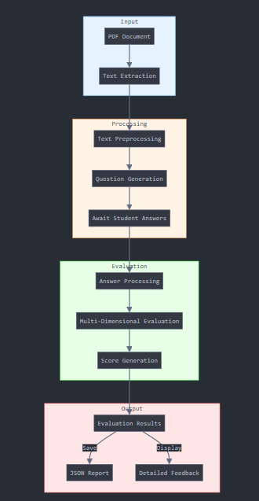
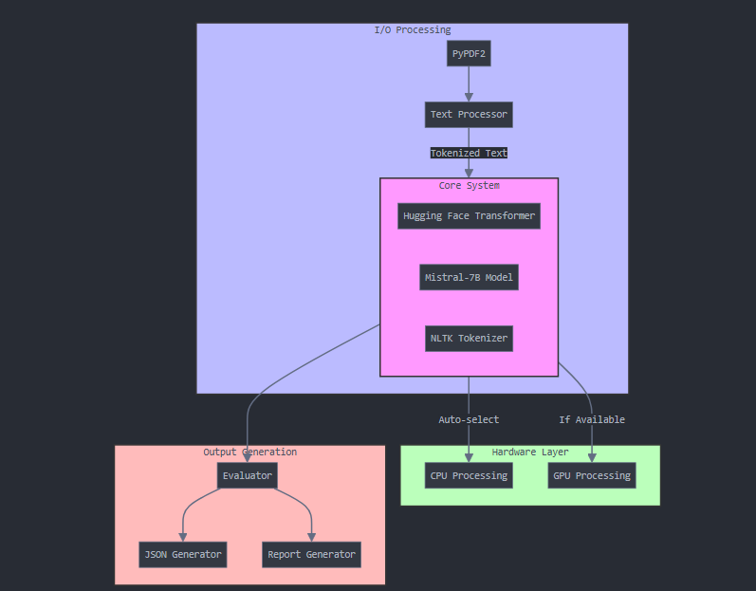
This system combines advanced AI with practical educational tools, creating an efficient and accurate assessment platform. It handles everything from document processing to detailed evaluation, providing comprehensive feedback for educational purposes.
IDEA/APPROACH DETAILS

Slide 5
TEAM DETAILS
Team Leader Name: Sharon Melhi
Student ID:A866132524004
Institution Name: Amity University , Bengaluru
Phone Number: 9867531323
Email ID: sharonmelhi365@gmail.com
Member 1 Name : Khushi Mhamane
Member 2 Name : Nikita Lotlikar
Member 3 Name :

